Slide 1
Applications of Data Science Paradigms An Overview
Karim Said Barsim, M.Sc.
21st, March 2018

Slide 2
Methods and Applications
Applications
Energy disaggregation
Load identification
Gesture recognition
Brain computer
interfaces
Computer vision
Rule-based …
Unsupervised
Learning Methods
Semi-supervised
Data-driven
Generative

Slide 3


Selective Sampling in Multi- Generative Adversarial Networks
5th February, 2018
Karim Said Barsim, Lirong Yang, and Bin Yang

Slide 4
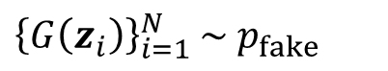
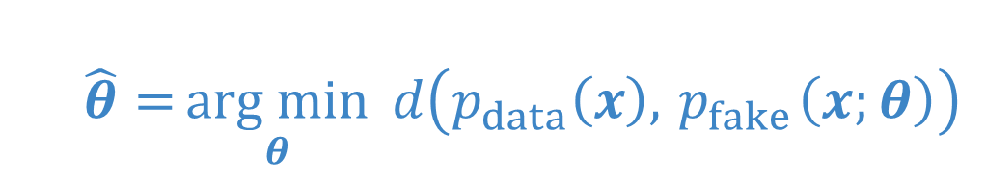
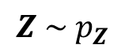
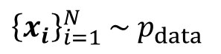
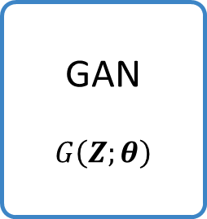
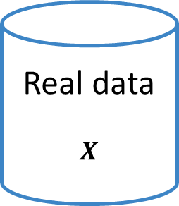
Generative Adversarial Nets (GAN) [1]
Learning to Generate Samples from an unknown Distribution
$$\hat{θ}={\underset{θ}{arg min}{ d\left(p_{data}\left(x\right),{ p}_{fake}\left(x;θ\right)\right)}}$$
Real data
$$X$$
${\left\{x_{i}\right\}}_{i=1}^{N}$ $\sim p_{data}$
GAN
$$G\left(Z;θ\right)$$
$$Z \sim p_{Z}$$
${\left\{G\left(z_{i}\right)\right\}}_{i=1}^{N}$ $\sim p_{fake}$
[1] Goodfellow, I. J., Pouget-Abadie, J., Mirza, M., Xu, B., Warde-Fareley, D., Ozair, S., Courville, A., and Bengio, Y. “Generative Adversarial Networks”, NIPS 2014 https://arxiv.org/abs/1406.2661

Slide 5
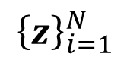
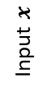
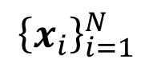
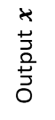
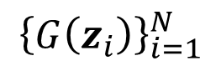

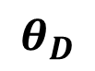
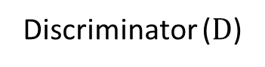
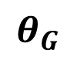
Architecture
Real data
Real
$${\left\{x_{i}\right\}}_{i=1}^{N}$$
Discriminator ($D$)
Real
Fake
Generator ($G$)
Input $x$
$$θ_{D}$$
$${\left\{z\right\}}_{i=1}^{N}$$
$${\left\{G\left(z_{i}\right)\right\}}_{i=1}^{N}$$
$$z$$
Fake
$$θ_{G}$$
Output $x$

Slide 6
Architecture
Real data
Real
$${\left\{x_{i}\right\}}_{i=1}^{N}$$
Discriminator ($D$)
Real
Fake
Generator ($G$)
Input $x$
$$θ_{D}$$
$${\left\{z\right\}}_{i=1}^{N}$$
$${\left\{G\left(z_{i}\right)\right\}}_{i=1}^{N}$$
$$z$$
Fake
$$θ_{G}$$
Output $x$

Slide 7
Architecture
Real data
Real
$${\left\{x_{i}\right\}}_{i=1}^{N}$$
Discriminator ($D$)
Real
Fake
Generator ($G$)
Input $x$
$$θ_{D}$$
$${\left\{z\right\}}_{i=1}^{N}$$
$${\left\{G\left(z_{i}\right)\right\}}_{i=1}^{N}$$
$$z$$
Fake
$$θ_{G}$$
Output $x$

Slide 8

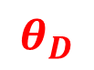
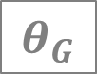
The GAN Game
Real data
Real
$${\left\{x_{i}\right\}}_{i=1}^{N}$$
Discriminator ($D$)
Real
Fake
Generator ($G$)
Input $x$
$$θ_{D}$$
$${\left\{z\right\}}_{i=1}^{N}$$
$${\left\{G\left(z_{i}\right)\right\}}_{i=1}^{N}$$
$$z$$
Fake
$$θ_{G}$$
Output $x$

Slide 9
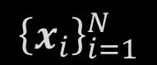
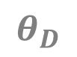
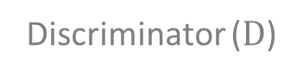
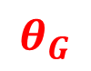
The GAN Game
Real data
Real
$${\left\{x_{i}\right\}}_{i=1}^{N}$$
Discriminator ($D$)
Real
Generator ($G$)
Input $x$
$$θ_{D}$$
$${\left\{z\right\}}_{i=1}^{N}$$
$${\left\{G\left(z_{i}\right)\right\}}_{i=1}^{N}$$
$$z$$
Fake
$$θ_{G}$$
Output $x$

Slide 10

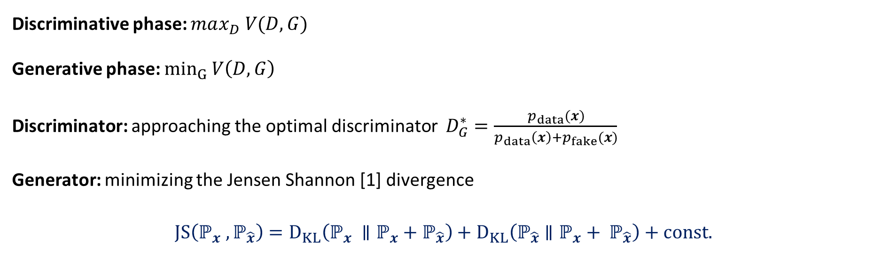
A $mini$-$max$ Game
$$\min_{G}{\max_{D}{V(D, G)}}=𝔼_{x\sim p_{data}\left(x\right)} [log⁡D(x) ]+ 𝔼_{z\sim p_{z}\left(z\right)} [log⁡(1 −D(G(z))) ]$$
Discriminative phase: $max_{D} V(D, G)$
Generative phase: $min_{G} V\left(D, G\right)$
Discriminator: approaching the optimal discriminator $D_{G}^{∗}=\frac{p_{data}(x)}{p_{data}\left(x\right)+p_{fake}(x)}$
Generator: minimizing the Jensen Shannon [1] divergence
$$JS\left(ℙ_{x} ,ℙ_{\hat{x}}\right)=D_{KL}\left(ℙ_{x} ∥ℙ_{x}+ℙ_{\hat{x}}\right)+D_{KL}\left(ℙ_{\hat{x}}∥{ℙ_{x}+ ℙ}_{\hat{x}}\right)+const.$$
[1] Jianhua Lin, “Divergence Measures Based on the Shannon Entropy,” IEEE Transactions on Information Theory, vol. 37, no. 1, pp. 145–151, Jan. 1991.

Slide 11
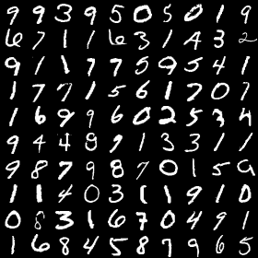
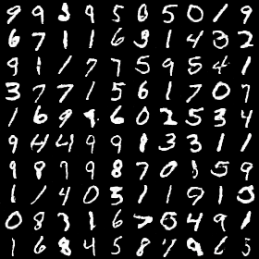
MNIST Experiments
Real or Fake ?

Slide 12
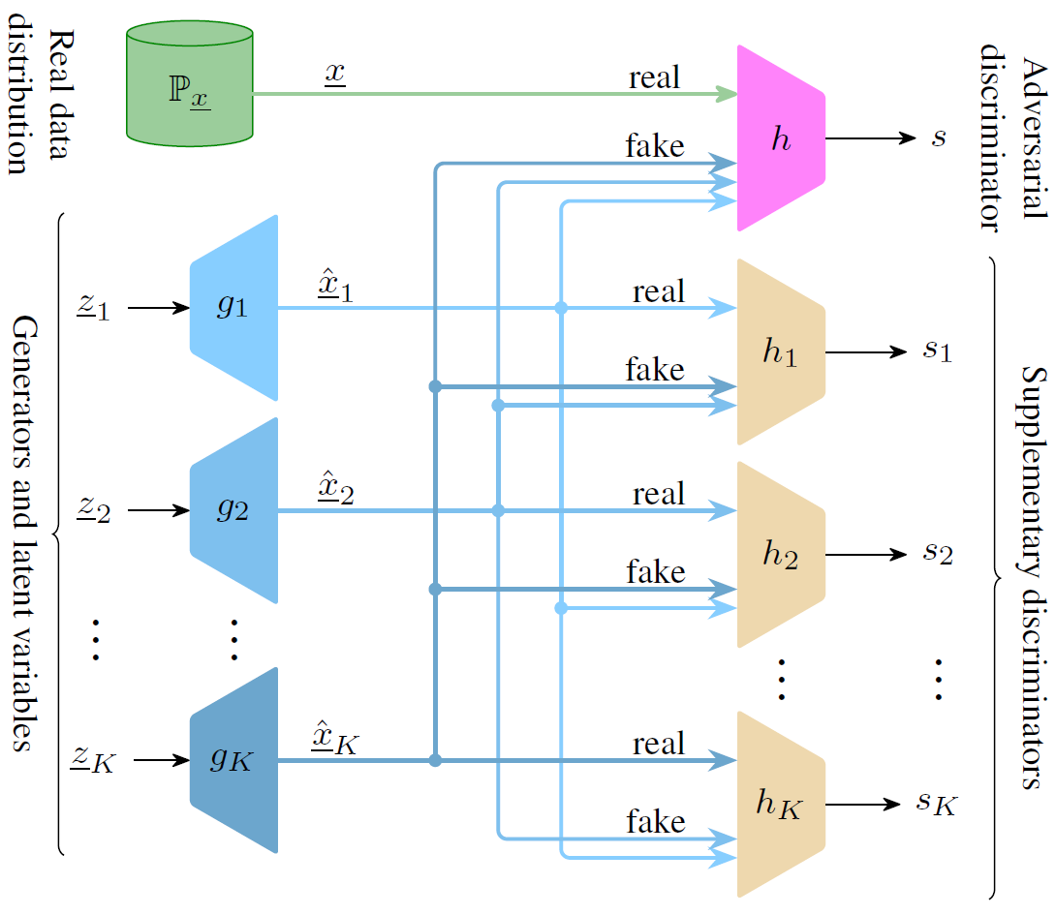
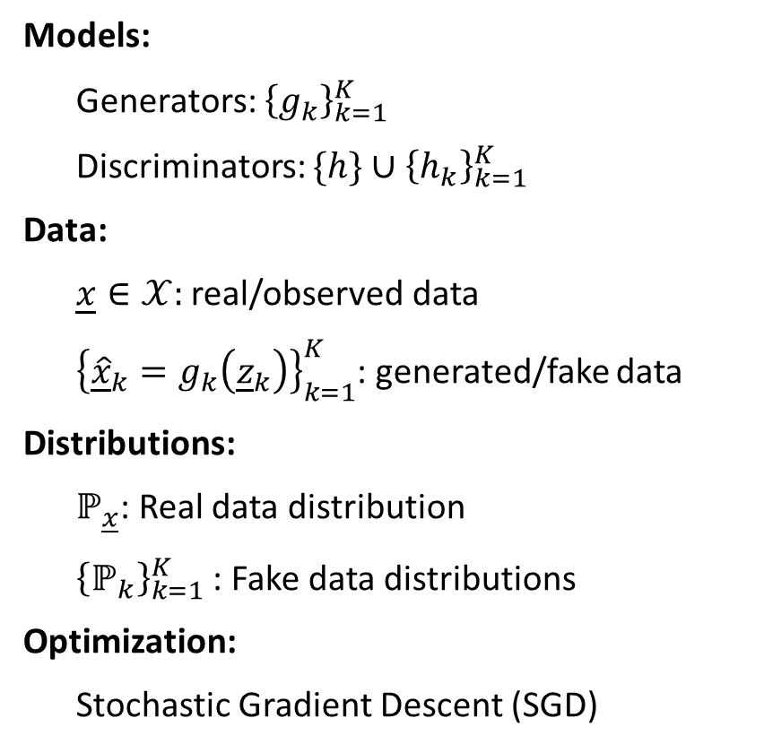
Multi-Generator GAN
Models:
Generators: ${\left\{g_{k}\right\}}_{k=1}^{K}$
Discriminators: $\{h\}∪{\left\{h_{k}\right\}}_{k=1}^{K}$
Data:
$\underline{x}∈𝒳:$ real/observed data
${\left\{{\underline{\hat{x}}}_{k}=g_{k}\left({\underline{z}}_{k}\right)\right\}}_{k=1}^{K}$: generated/fake data
Distributions:
$ℙ_{\underline{x}}$: Real data distribution
${\left\{ℙ_{k}\right\}}_{k=1}^{K}$: Fake data distributions
Optimization:
Stochastic Gradient Descent (SGD)

Slide 13

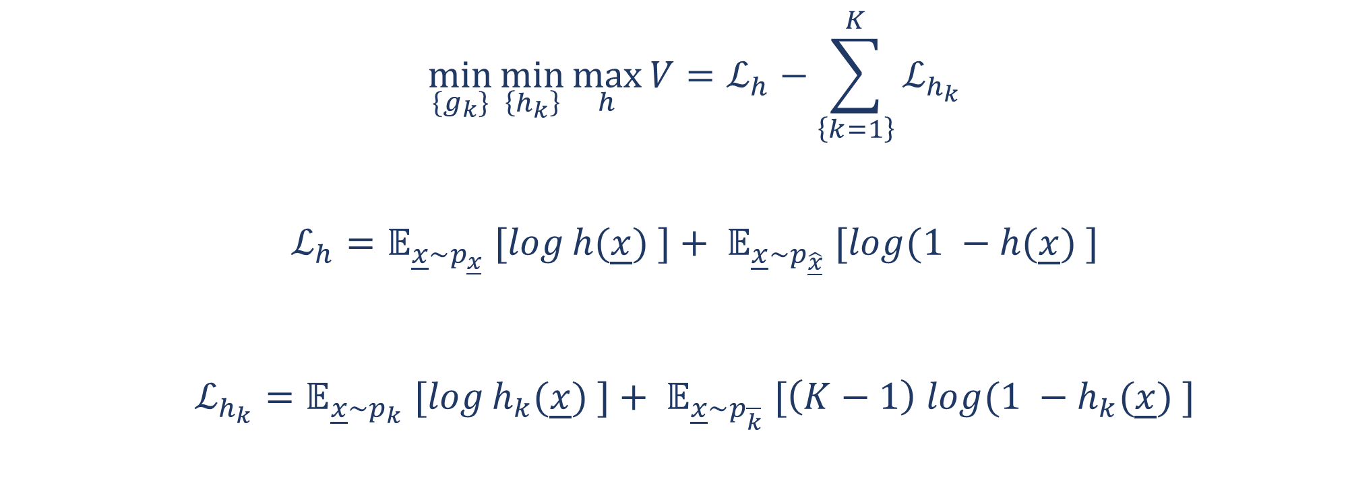
A $mini$-$mini$-$max$ Game
$$\min_{\{g_{k}\}}{\min_{\left\{h_{k}\right\}}{\max_{h}}V}=ℒ_{h}−\sum_{\left\{k=1\right\}}^{K}{ℒ_{h_{k}}}$$
$$ℒ_{h}=𝔼_{\underline{x}\sim p_{\underline{x}}} [log⁡h(\underline{x}) ]+ 𝔼_{\underline{x}\sim p_{\underline{\hat{x}}}} [log⁡(1 −h(\underline{x}) ]$$
$$ℒ_{h_{k}}=𝔼_{\underline{x}\sim p_{k}} [log⁡h_{k}(\underline{x}) ]+ 𝔼_{\underline{x}\sim p_{\overline{k}}} [\left(K−1\right) log⁡(1 −h_{k}(\underline{x}) ]$$

Slide 14
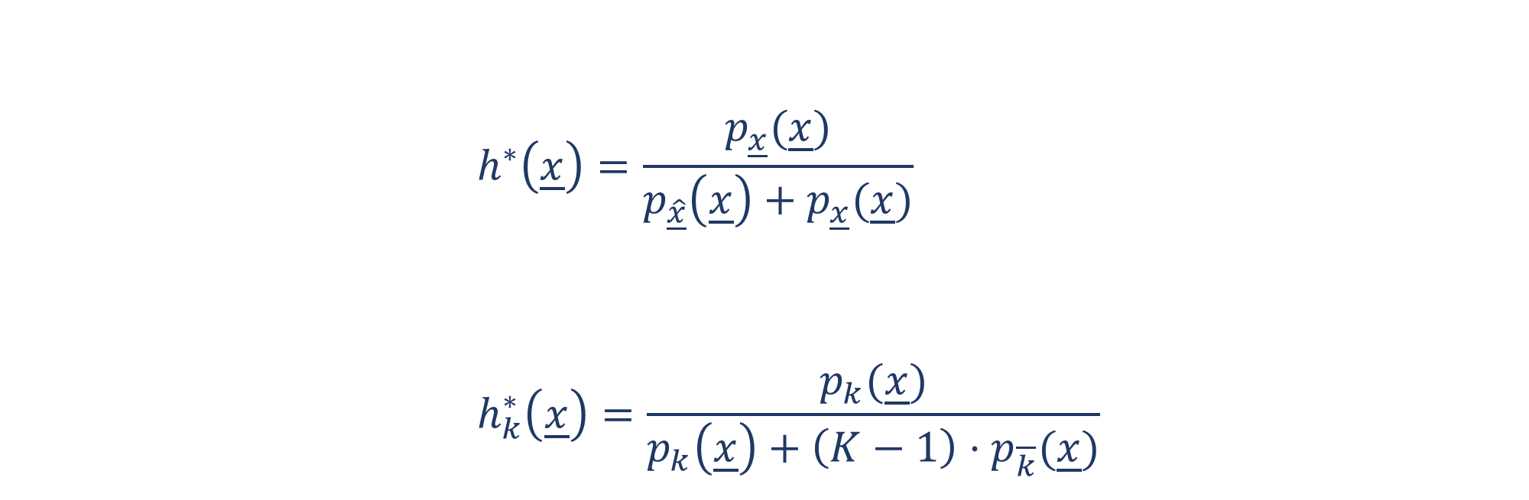
Discrimination
$$h^{∗}\left(\underline{x}\right)=\frac{p_{\underline{x}}(\underline{x})}{p_{\underline{\hat{x}}}\left(\underline{x}\right)+p_{\underline{x}}(\underline{x})} \\ h_{k}^{∗}\left(\underline{x}\right)=\frac{p_{k}(\underline{x})}{p_{k}\left(\underline{x}\right)+\left(K−1\right)⋅p_{\overline{k}}(\underline{x})}$$

Slide 15
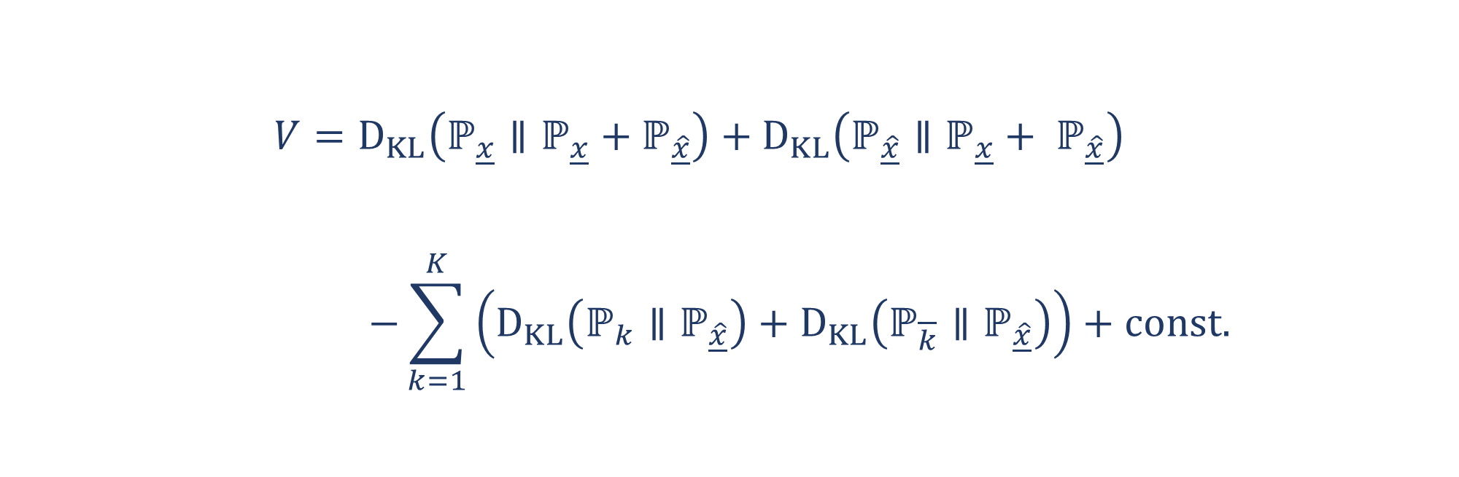


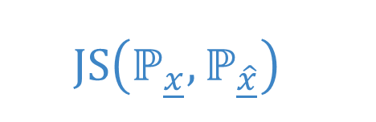
Generation
$$JS\left(ℙ_{\underline{x}},ℙ_{\hat{\underline{x}}}\right)$$
$$V=D_{KL}\left(ℙ_{\underline{x}}∥ℙ_{\underline{x}}+ℙ_{\hat{\underline{x}}}\right)+D_{KL}\left(ℙ_{\hat{\underline{x}}}∥ℙ_{\underline{x}}+ ℙ_{\hat{\underline{x}}}\right) \\ −\sum_{k=1}^{K}{\left(D_{KL}\left(ℙ_{k}∥ℙ_{\hat{\underline{x}}}\right)+D_{KL}\left(ℙ_{\overline{k}}∥ℙ_{\hat{\underline{x}}}\right)\right)}+const.$$
Prevalence
Vanishment

Slide 16
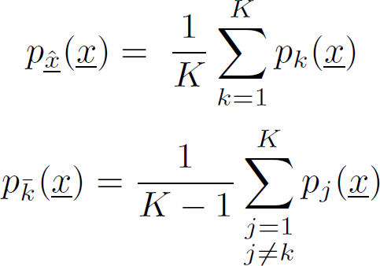
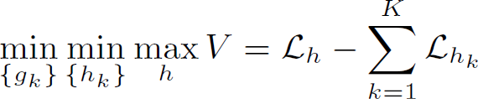
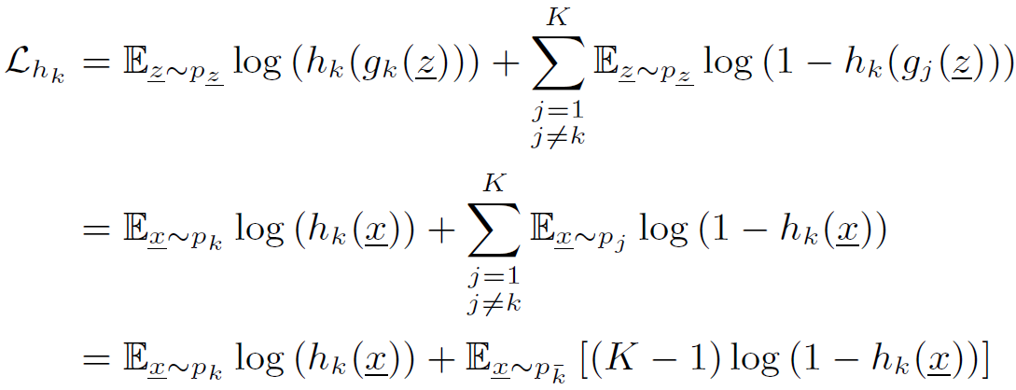
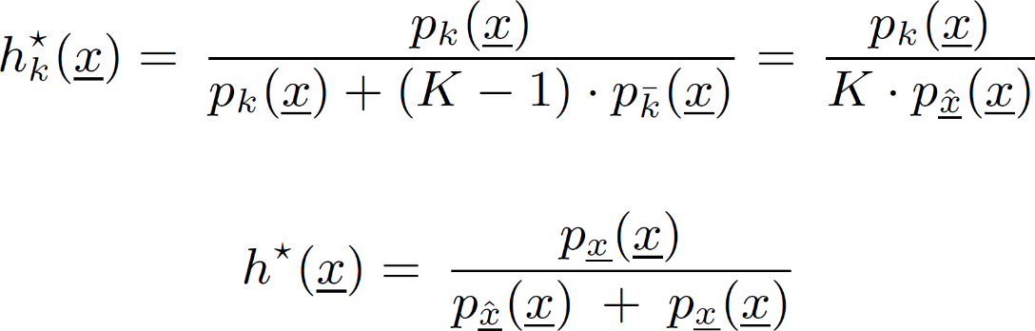
Derivation and Proof

Slide 17
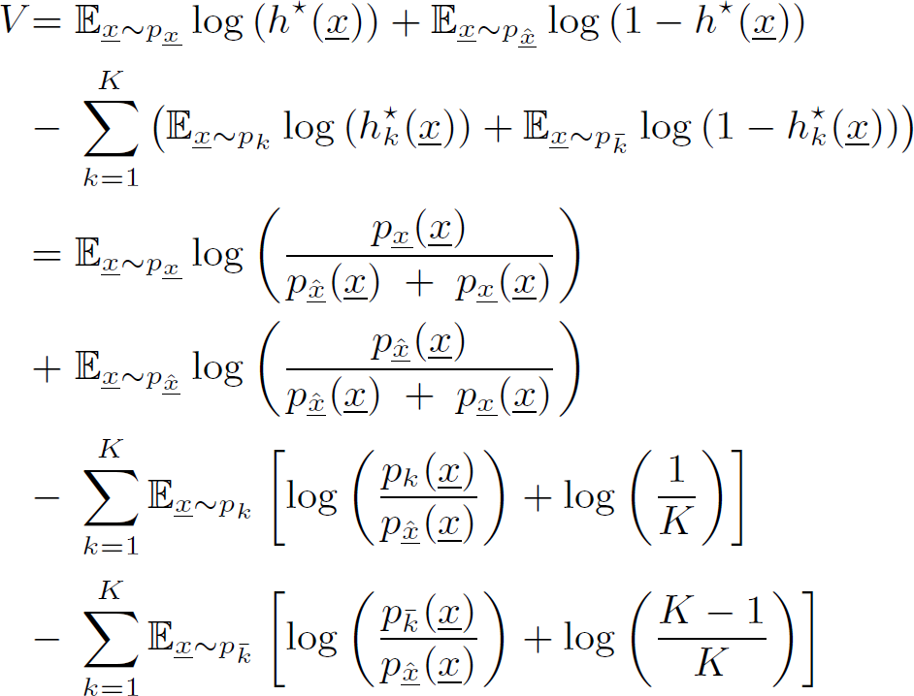
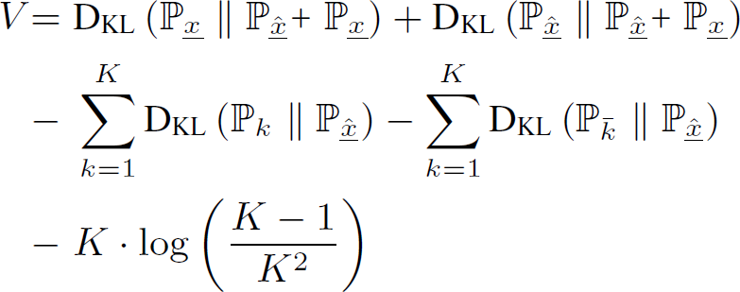
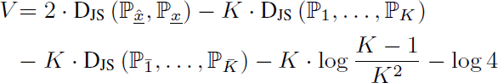
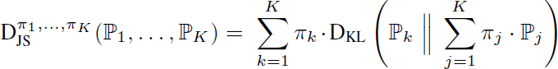
Derivation and Proof

Slide 18
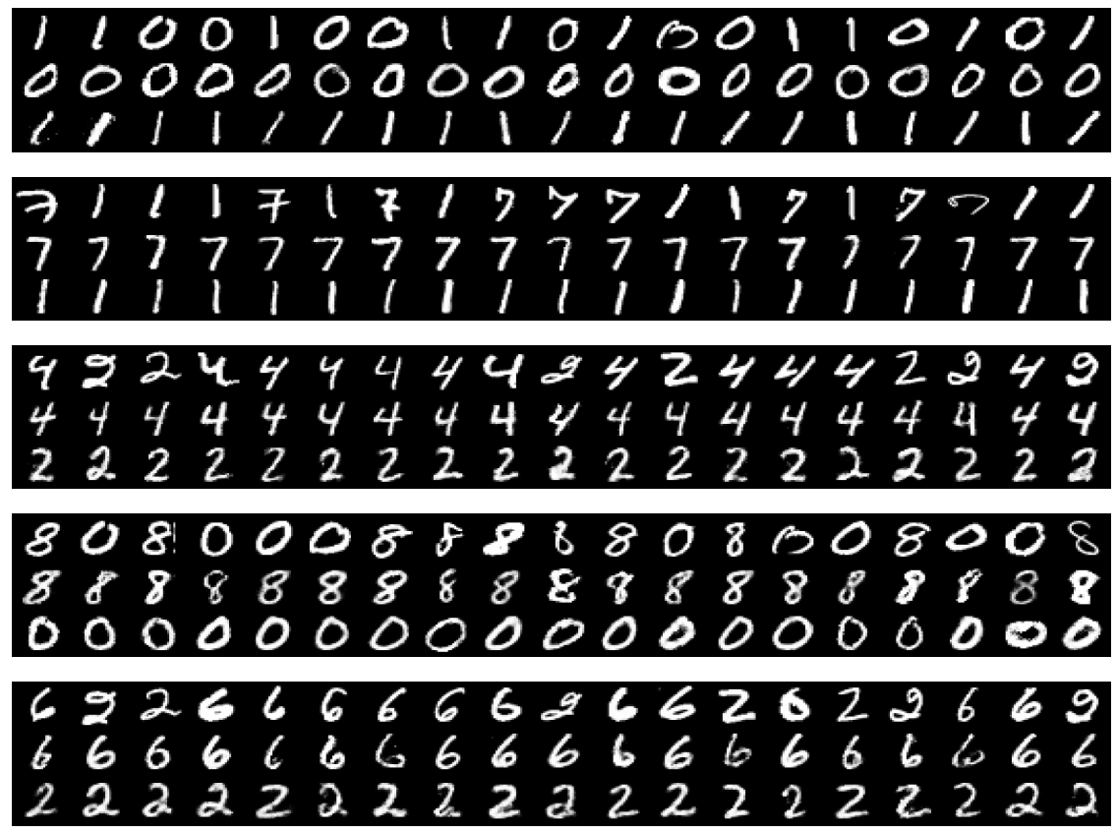
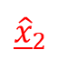
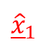
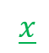
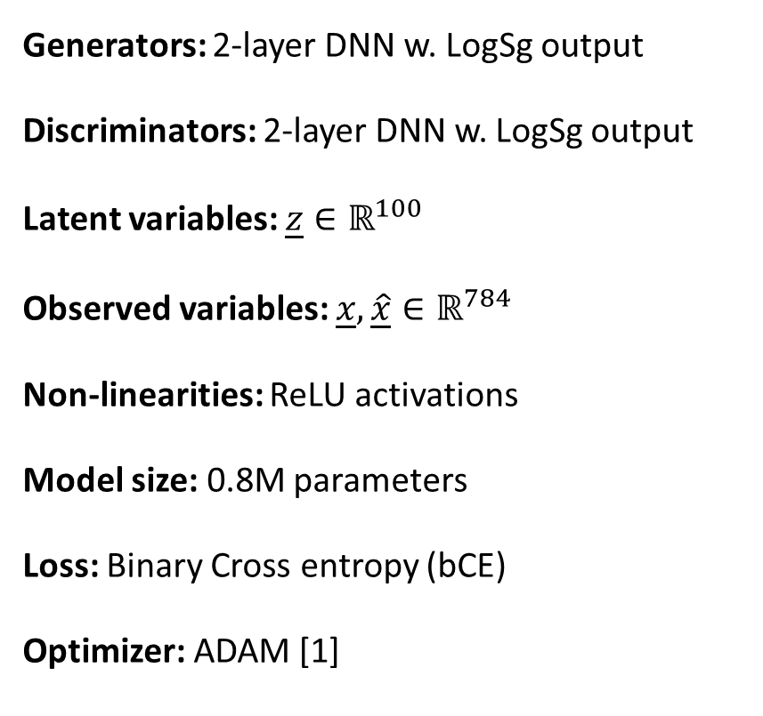
Experiments: 2 digits
Generators: 2-layer DNN w. LogSg output
Discriminators: 2-layer DNN w. LogSg output
Latent variables: $\underline{z}∈ℝ^{100}$
Observed variables: $\underline{x},\underline{\hat{x}}∈ℝ^{784}$
Non-linearities: ReLU activations
Model size: 0.8M parameters
Loss: Binary Cross entropy (bCE)
Optimizer: ADAM [1]
$$\underline{x}$$
$${\underline{\hat{x}}}_{1}$$
$${\underline{\hat{x}}}_{2}$$
[1] Diederik P. Kingma and Jimmy Lei Ba, “Adam: A Method for Stochastic Optimization,” ArXiv e-prints, Dec. 2014, arXiv:1412.6980v9.

Slide 19
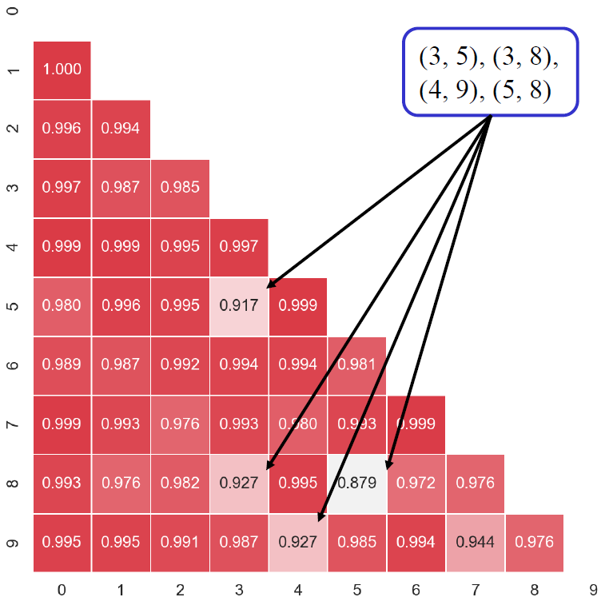
Evaluation

Slide 20
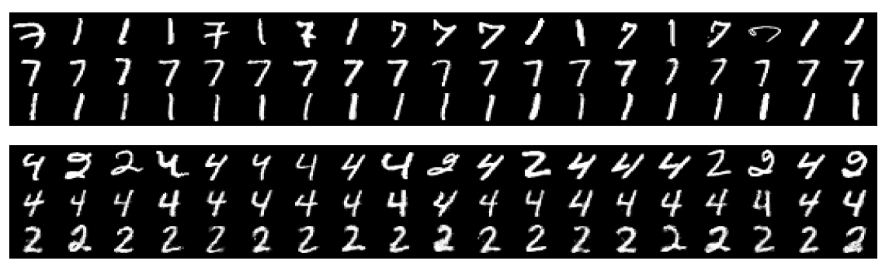
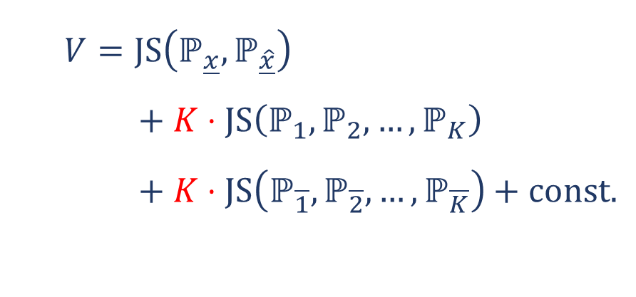
Limitations
Optimization: local optimum
Sampling/Generation: mode collapse
Loss function: imbalanced objectives
$$V=JS\left(ℙ_{\underline{x}},ℙ_{\hat{\underline{x}}}\right) \\ + K⋅JS\left(ℙ_{1},ℙ_{2}, …,ℙ_{K}\right) \\ + K⋅JS\left(ℙ_{\overline{1}},ℙ_{\overline{2}}, …,ℙ_{\overline{K}}\right)+const.$$

Slide 21
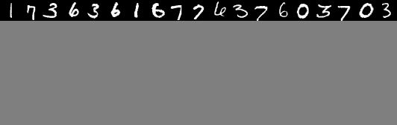
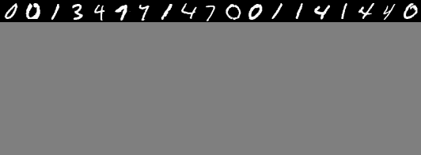
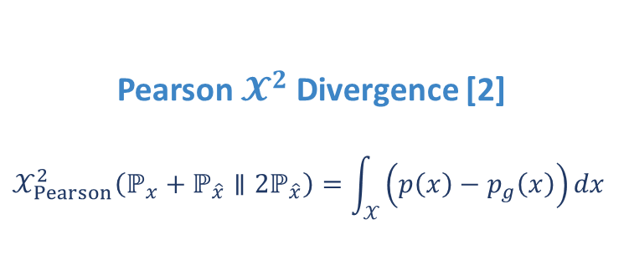
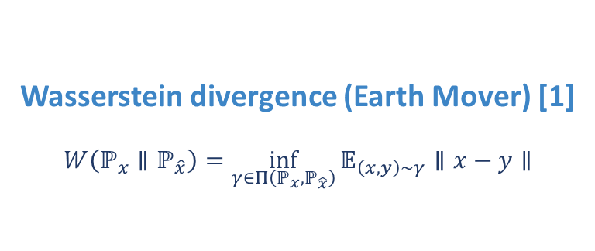
Experiments: 5 digits
Wasserstein divergence (Earth Mover) [1]
$$W\left(ℙ_{x}∥ℙ_{\hat{x}}\right)=\inf_{γ∈Π\left(ℙ_{x},ℙ_{\hat{x}}\right)}{𝔼_{\left(x, y\right)∼γ}∥x−y∥}$$
Pearson $𝓧^{2}$ Divergence [2]
$$𝒳_{Pearson}^{2}\left(ℙ_{x}+ℙ_{\hat{x}}∥{2ℙ}_{\hat{x}}\right)=\int_{𝒳}{\left(p\left(x\right)−p_{g}\left(x\right)\right)}dx$$
[1] M. Arjovsky et. al. “Wasserstein GAN” ArXiv e-prints, Dec. 2017, arXiv:1701.07875.
[2] X. Mao et. al. “Least Squares Generative Adversarial Networks” ArXiv e-prints, Nov. 2016, arXiv:1611.04076.

Slide 22
Experiments: Earth Mover

Slide 23
Experiments: Pearson Divergence

Slide 24
Experiments: Pearson Divergence

Slide 25
Conclusion
Next time …
[1] J. Zhu et. al. “Unpaired image-to-image translation using cycle-consistent adversarial networks[J]. arXiv preprint arXiv:1703.10593, 2017.
[2] C. Ledig el. al. “Photo-realistic single image super-resolution using a generative adversarial network[J]. arXiv preprint arXiv:1609.04802, 2016.
[3] S. Reed et. al. “Generative adversarial text to image synthesis[J]. arXiv:1605.05396, 2016.
[4] B. Yang et. al. “3D object reconstruction from a single depth view with adversarial learning”, arXiv preprint arXiv:1708.07969, 2017.
[5] A. Radford et. al. “Unsupervised representation learning with deep convolutional generative adversarial networks”, arXiv:1511.06434, 2015.
[6] C. Sønderby et. al. “Amortised map inference for image super-resolution”, arXiv:1610.04490, 2016.
[7] T. Miyato et. al. “Spectral Normalization for Generative Adversarial Networks”, ICML Implicit Models Workshop. 2017.

Slide 26
Attention-based Spellers for BCI Applications
30th November, 2017
Wangbo Zheng, Karim Said Barsim, and Bin Yang

Slide 27
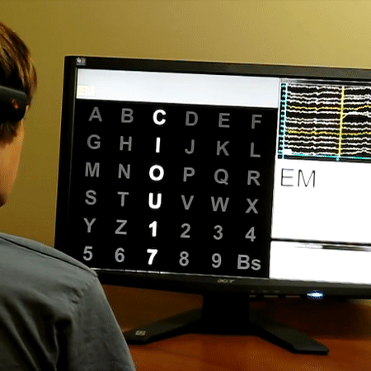

Slide 28
Attention-based BCI System
A B C D E F
G H I J K L
M N O P Q R
S T U V W X
Y Z 1 2 3 4
5 6 7 8 9 _
Stimulus Controller
Visual stimulus
elicitation
Fp1
Fp2
F7
F3
Fz
F4
F8
EEG Signal Acquisition
P300-ERP
Detection
Symbol Recognition
T3
C3
Cz
C4
T4
T5
P3
Pz
P4
T6
O1
O2
Estimated symbol
(e.g. T)
International 10-20 System

Slide 29

The Oddball Principle

Slide 30


Slide 31
Dataset
BCI Competition III [1]
Subjects: 2 anonymous subjects (A / B)
Signals: 64 channel-Electro-EncephaloGraphic (EEG) signals
Sampling: 240Hz
Targets: 36 (6x6) symbols
Training set: 85 symbols x 15 repetitions
Evaluation set: 100 symbols x 15 repetitions
[1] Brain-Computer-Interface (BCI) Competition III 2004/2005, P300 Speller Paradigm: http://www.bbci.de/competition/iii/

Slide 32

Objective
P300 Waveform detection for an attention-based BCI Speller
P300: an evoked positive deflection phase locked a rare external stimulus
Detection: using a binary classification system
Attention-based: adopting to the oddball paradigm
Speller: targeting alpha-numeric characters
P300 Speller
Estimated symbol
(e.g. T)

Slide 33
Hand Gesture Recognition for Automatic Assembly Validation
30th November, 2017
Karim Said Barsim, Hao Wang, and Bin Yang
Confidential [A.Raymond (Rayce EURL)]

Slide 34
Neural Network Ensembles to Real-time Plug-level Load Identification
30th November, 2017
Karim Said Barsim, and Bin Yang

Slide 35

VI-Trajectories

Slide 36
Unsupervised Load Monitoring and Disaggregation
30th November, 2017
Karim Said Barsim, Roman Streubel, and Bin Yang

Slide 37

Non-Intrusive Load Monitoring
Estimating End-Use Consumption from Building-level Measurements
[1] Smart Energy Efficiency http://smartenergyefficiency.eu/

Slide 38
VI-Trajectories

Slide 39
Semi-supervised Event-based Energy Monitoring and Disaggregation
30th November, 2017
Karim Said Barsim and Bin Yang

Slide 40


Toy Experiment
Classification problem:
The double crescent problem
1000 samples/class.
Learner/Classifier:
Support Vector Machine (SVM).
Gaussian kernel $e^{−{\left\|x_{i}−x_{j}\right\|}^{2}}$
Minimal labelling (1 sample/class)
Selection:
Farthest from boundary.
Training:
300 Iterations $>70\%$
500 Iterations $>80\%$
700 iterations $>90\%$
1000 iterations: optimal

Slide 41


Toy Experiment
Classification problem:
The double crescent problem
1000 samples/class.
Learner/Classifier:
Support Vector Machine (SVM).
Gaussian kernel $e^{−{\left\|x_{i}−x_{j}\right\|}^{2}}$
Minimal labelling (1 sample/class)
Selection:
Farthest from boundary.
Training:
300 Iterations $>70\%$
500 Iterations $>80\%$
700 iterations $>90\%$
1000 iterations: optimal

Slide 42


Toy Experiment
Classification problem:
The double crescent problem
1000 samples/class.
Learner/Classifier:
Support Vector Machine (SVM).
Gaussian kernel $e^{−{\left\|x_{i}−x_{j}\right\|}^{2}}$
Minimal labelling (1 sample/class)
Selection:
Farthest from boundary.
Training:
300 Iterations $>70\%$
500 Iterations $>80\%$
700 iterations $>90\%$
1000 iterations: optimal

Slide 43


Toy Experiment
Classification problem:
The double crescent problem
1000 samples/class.
Learner/Classifier:
Support Vector Machine (SVM).
Gaussian kernel $e^{−{\left\|x_{i}−x_{j}\right\|}^{2}}$
Minimal labelling (1 sample/class)
Selection:
Farthest from boundary.
Training:
300 Iterations $>70\%$
500 Iterations $>80\%$
700 iterations $>90\%$
1000 iterations: optimal

Slide 44


Toy Experiment
Classification problem:
The double crescent problem
1000 samples/class.
Learner/Classifier:
Support Vector Machine (SVM).
Gaussian kernel $e^{−{\left\|x_{i}−x_{j}\right\|}^{2}}$
Minimal labelling (1 sample/class)
Selection:
Farthest from boundary.
Training:
300 Iterations $>70\%$
500 Iterations $>80\%$
700 iterations $>90\%$
1000 iterations: optimal

Slide 45
Generic Deep Disaggregation for Single-Load Extraction
7th March, 2018
Karim Said Barsim and Bin Yang

Slide 46

Neural Network Architecture
Model: dilated convolutional NN
U-Net: skip connections
ResNet: residual connections
Non-linearity: Leaky ReLU
Regularization:
Batch normalization
Noise Injection

